Slide 1

Enter presentation title here
Subtitle

Slide 2
Enter presentation title here
Subtitle

Slide 3

Enter presentation title here
Subtitle

Slide 4
Enter presentation title here
Subtitle

Slide 5

Section Title
01

Slide 6

Section Title
01

Slide 7

Section Title
01

Slide 8

Section Title
01

Slide 9
Thank You

Slide 10
Thank You

Slide 11

Thank You
Ascendion provides digital engineering services that power growth and deliver captivating experiences to consumers and employees. Our applied AI, engineering, cloud, data, experience design, and talent transformation capabilities accelerate innovation for Global 2000 clients. Headquartered in New Jersey, our workforce delivers solutions from around the globe.

Slide 12
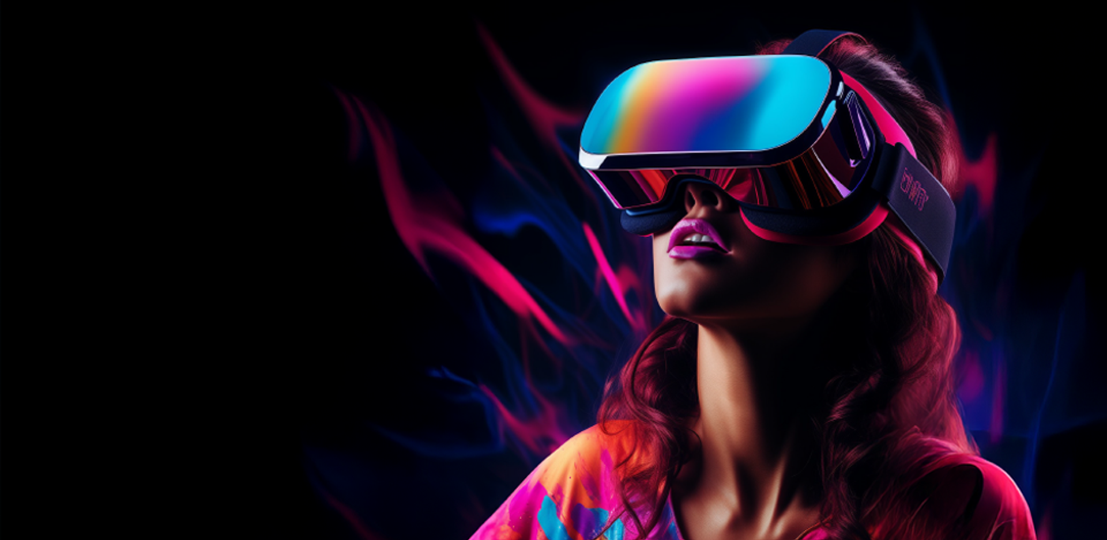
Thank You
Ascendion provides digital engineering services that power growth and deliver captivating experiences to consumers and employees. Our applied AI, engineering, cloud, data, experience design, and talent transformation capabilities accelerate innovation for Global 2000 clients. Headquartered in New Jersey, our workforce delivers solutions from around the globe.

Slide 13

Thank You

Slide 24
Ascendion provides digital engineering services that power growth and deliver captivating experiences to consumers and employees. Our applied AI, engineering, cloud, data, experience design, and talent transformation capabilities accelerate innovation for Global 2000 clients. Headquartered in New Jersey, our workforce delivers solutions from around the globe.

Slide 25
Ascendion provides digital engineering services that power growth and deliver captivating experiences to consumers and employees. Our applied AI, engineering, cloud, data, experience design, and talent transformation capabilities accelerate innovation for Global 2000 clients. Headquartered in New Jersey, our workforce delivers solutions from around the globe.

Slide 37
Ascendion provides digital engineering services that power growth and deliver captivating experiences to consumers and employees. Our applied AI, engineering, cloud, data, experience design, and talent transformation capabilities accelerate innovation for Global 2000 clients. Headquartered in New Jersey, our workforce delivers solutions from around the globe.

Slide 38
Ascendion provides digital engineering services that power growth and deliver captivating experiences to consumers and employees. Our applied AI, engineering, cloud, data, experience design, and talent transformation capabilities accelerate innovation for Global 2000 clients. Headquartered in New Jersey, our workforce delivers solutions from around the globe.

